Slide 1
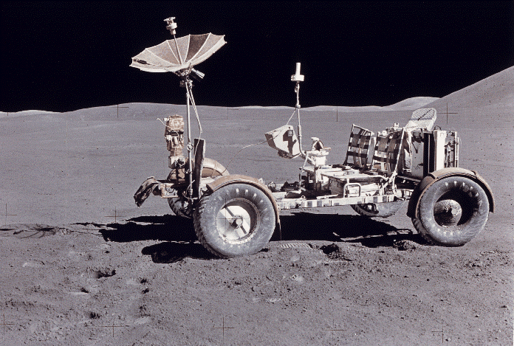
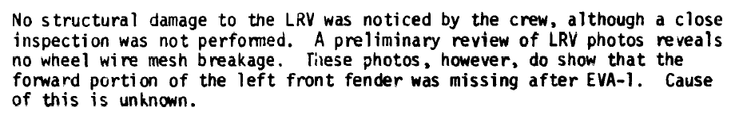
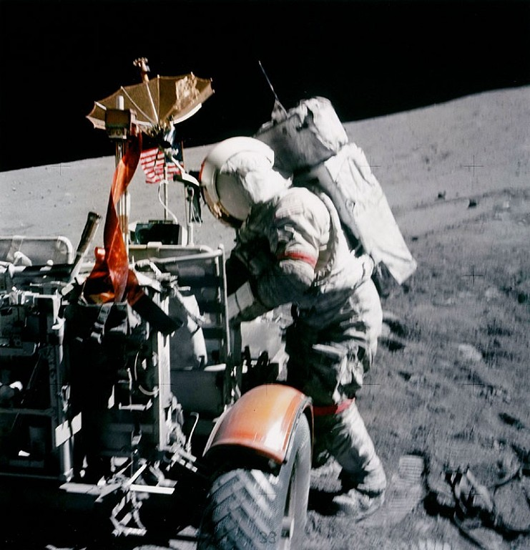
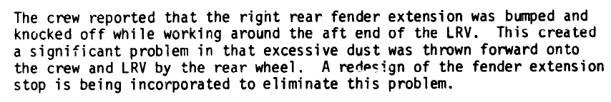
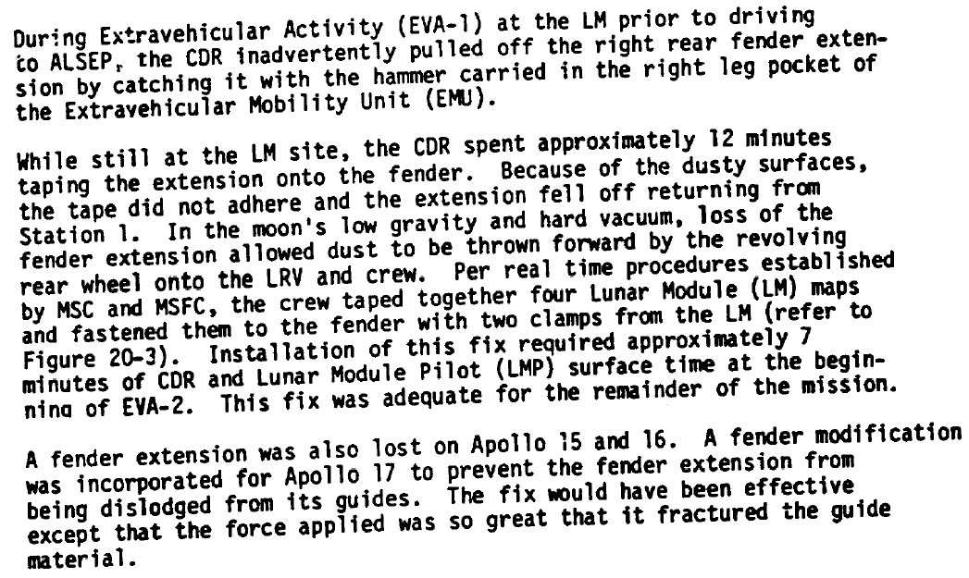
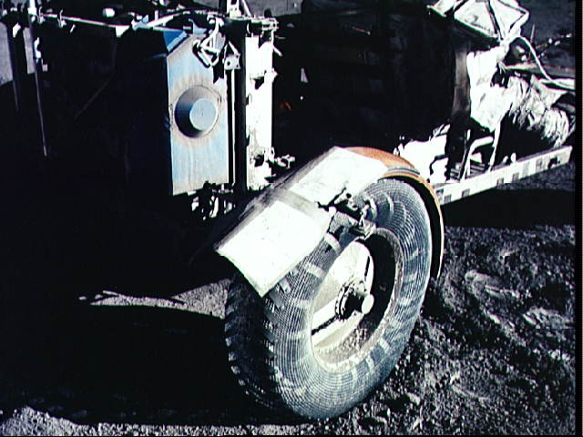
Extracts From Apollo Flight Evaluation Reports
Loss of LRV left front fender extension on Apollo 15
Loss of LRV right rear fender extension on Apollo 16
Loss of LRV right rear fender extension on Apollo 17
ronald.a.creel@saic.com 8/28/04

